Slide 1
Module -2
PROCESS MODELS
Prof. Perepi. Rajarajeswari

Slide 2
Life cycle models
Waterfall Model.
V-Shaped Model.
Iterative Model.
Spiral Model.
Big Bang Model.
Agile Model.

Slide 3
Waterfall Model
The waterfall Model illustrates the software development process in a linear sequential flow. This means that any phase in the development process begins only if the previous phase is complete. In this waterfall model, the phases do not overlap.

Slide 4
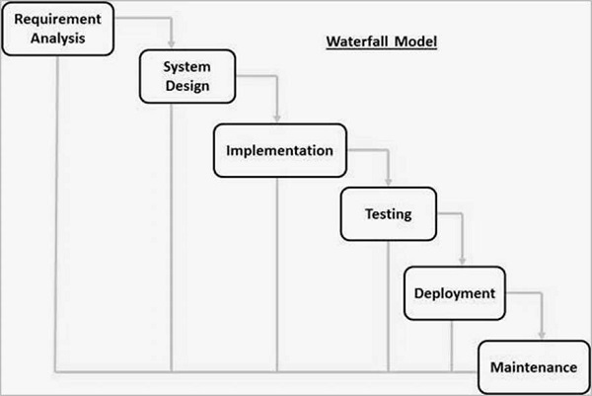
Life cycle model stages

Slide 5
Waterfall Model - Application
Every software developed is different and requires a suitable SDLC approach to be followed based on the internal and external factors.
Some situations where the use of Waterfall model is most appropriate are −
Requirements are very well documented, clear and fixed.
Product definition is stable.
Technology is understood and is not dynamic.
There are no ambiguous requirements.
Ample resources with required expertise are available to support the product.
The project is short.

Slide 6
Advantages
Some of the major advantages of the Waterfall Model are as follows −
Simple and easy to understand and use
Easy to manage due to the rigidity of the model. Each phase has specific deliverables and a review process.
Phases are processed and completed one at a time.
Works well for smaller projects where requirements are very well understood.
Clearly defined stages.
Well understood milestones.
Easy to arrange tasks.

Slide 7
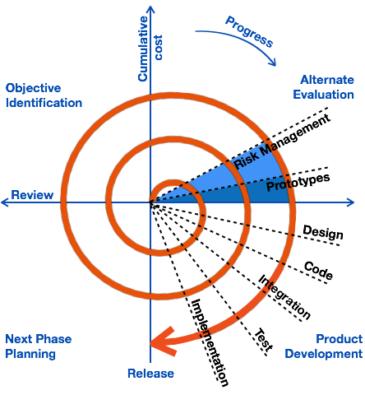
SPRIAL MODEL

Slide 8
The spiral model has four phases. A software project repeatedly passes through these phases in iterations called Spirals.
Identification
This phase starts with gathering the business requirements in the baseline spiral. In the subsequent spirals as the product matures, identification of system requirements, subsystem requirements and unit requirements are all done in this phase.
This phase also includes understanding the system requirements by continuous communication between the customer and the system analyst. At the end of the spiral, the product is deployed in the identified market.
The Design phase starts with the conceptual design in the baseline spiral and involves architectural design, logical design of modules, physical product design and the final design in the subsequent spirals.

Slide 9
Construct or Build
The Construct phase refers to production of the actual software product at every spiral. In the baseline spiral, when the product is just thought of and the design is being developed a POC (Proof of Concept) is developed in this phase to get customer feedback.
Then in the subsequent spirals with higher clarity on requirements and design details a working model of the software called build is produced with a version number. These builds are sent to the customer for feedback.
Evaluation and Risk Analysis
Risk Analysis includes identifying, estimating and monitoring the technical feasibility and management risks, such as schedule slippage and cost overrun. After testing the build, at the end of first iteration, the customer evaluates the software and provides feedback.
The following illustration is a representation of the Spiral Model, listing the activities in each phase.

Slide 10
Spiral Model - Pros and Cons
The advantages of the Spiral SDLC Model are as follows −
Changing requirements can be accommodated.
Allows extensive use of prototypes.
Requirements can be captured more accurately.
Users see the system early.
Development can be divided into smaller parts and the risky parts can be developed earlier which helps in better risk management.
The disadvantages of the Spiral SDLC Model are as follows −
Management is more complex.
End of the project may not be known early.
Not suitable for small or low risk projects and could be expensive for small projects.
Process is complex
Spiral may go on indefinitely.
Large number of intermediate stages requires excessive documentation.

Slide 11
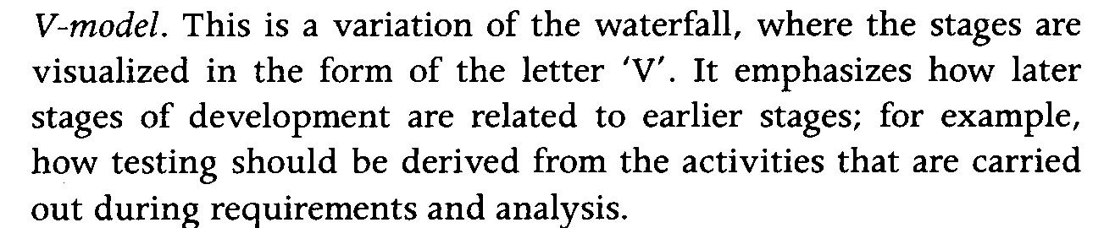
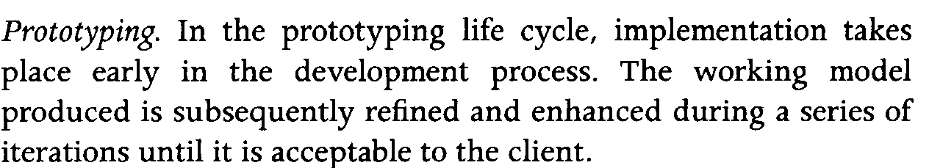

Slide 12
Unified Process
The name Unified Process as opposed to Rational Unified Process is generally used to describe the generic process, including those elements which are common to most refinements.
The Unified Process name is also used to avoid potential issues of trademark infringement since Rational Unified Process and RUP are trademarks of IBM

Slide 13
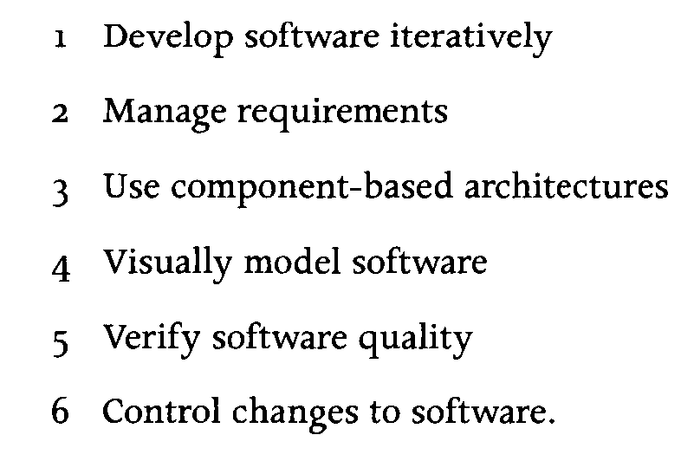

Slide 14
Incremental Model
Incremental Model is a process of software development where requirements divided into multiple standalone modules of the software development cycle.
In this model, each module goes through the requirements, design, implementation and testing phases. Every subsequent release of the module adds function to the previous release.
The process continues until the complete system achieved.

Slide 15
phases of incremental model
The various phases of incremental model are as follows:
1. Requirement analysis: In the first phase of the incremental model, the product analysis expertise identifies the requirements. And the system functional requirements are understood by the requirement analysis team. To develop the software under the incremental model, this phase performs a crucial role.
2. Design & Development: In this phase of the Incremental model of SDLC, the design of the system functionality and the development method are finished with success. When software develops new practicality, the incremental model uses style and development phase.
3. Testing: In the incremental model, the testing phase checks the performance of each existing function as well as additional functionality. In the testing phase, the various methods are used to test the behavior of each task.
4. Implementation: Implementation phase enables the coding phase of the development system. It involves the final coding that design in the designing and development phase and tests the functionality in the testing phase. After completion of this phase, the number of the product working is enhanced and upgraded up to the final system product

Slide 16
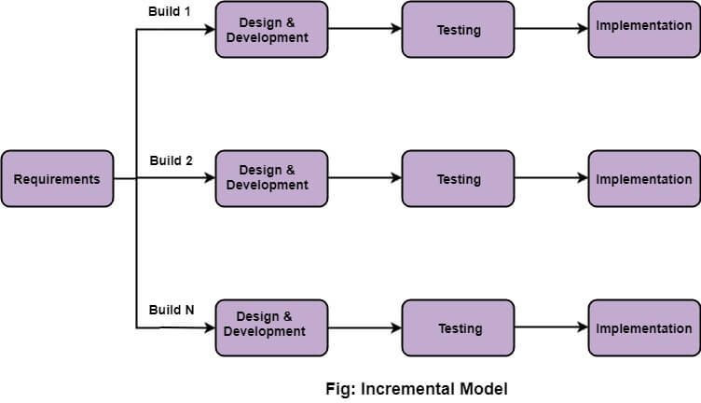

Slide 17
When we use the Incremental Model?
When the requirements are superior.
A project has a lengthy development schedule.
When Software team are not very well skilled or trained.
When the customer demands a quick release of the product.
You can develop prioritized requirements first.
Advantage of Incremental Model
Errors are easy to be recognized.
Easier to test and debug
More flexible.
Simple to manage risk because it handled during its iteration.
The Client gets important functionality early.

Slide 18
Agile process model
Agile Model
The meaning of Agile is swift or versatile."Agile process model" refers to a software development approach based on iterative development. Agile methods break tasks into smaller iterations, or parts do not directly involve long term planning.
The project scope and requirements are laid down at the beginning of the development process. Plans regarding the number of iterations, the duration and the scope of each iteration are clearly defined in advance.
Each iteration is considered as a short time "frame" in the Agile process model, which typically lasts from one to four weeks. The division of the entire project into smaller parts helps to minimize the project risk and to reduce the overall project delivery time requirements.
Each iteration involves a team working through a full software development life cycle including planning, requirements analysis, design, coding, and testing before a working product is demonstrated to the client.

Slide 19
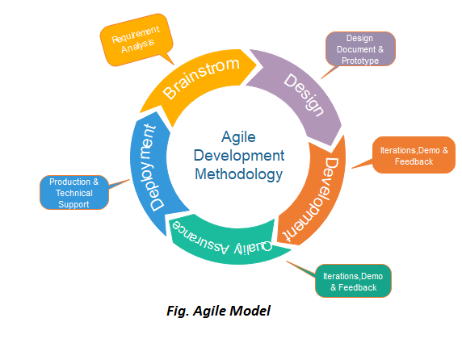

Slide 20
Phases of Agile Model:
Following are the phases in the Agile model are as follows:
Requirements gathering
Design the requirements
Construction/ iteration
Testing/ Quality assurance
Deployment
Feedback

